Slide 1
MCA Final Year Project (Review III) Fake Signature Detection
Submitted to the Presidency University, Bengaluru in partial fulfillment for the award of the degree of Master of Computer Applications(MCA)
Project Number : MCA_PR220
Under the supervision of
MR. S. Sakthi Asst. Prof.-SCSE School of Computer Science and Engineering
Name | Roll Number
Aakash K | 20232MCA0034

Slide 2
Content
Problem Statement
Literature Survey
Tools and Technologies to be used
Timeline of the Project
GitHub link
References

Slide 3
Problem Statement
Forgery of handwritten signatures is a significant challenge in banking, legal documentation, and identity verification systems. Manual signature verification methods are time-consuming, error-prone, and inefficient against sophisticated forgeries. There is a need for an automated fake signature detection system that leverages image processing techniques to accurately differentiate between genuine and forged signatures. This project aims to develop a reliable, efficient, and automated solution to detect forged signatures, thereby enhancing security and reducing fraud risks.

Slide 4
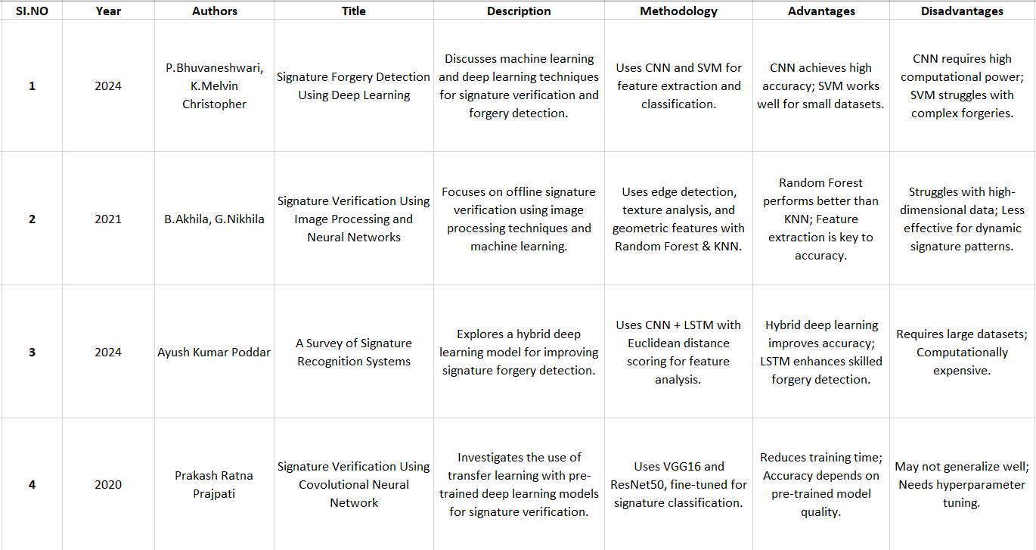
Literature Review

Slide 5
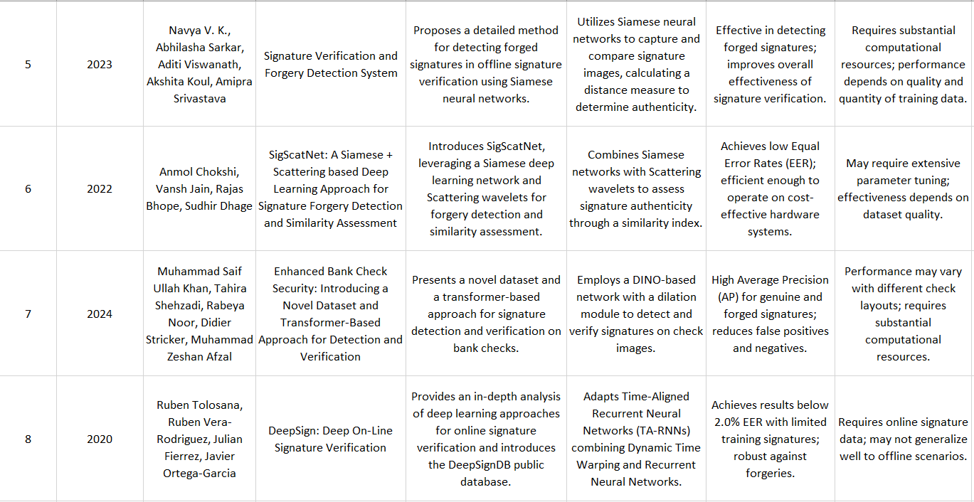

Slide 6
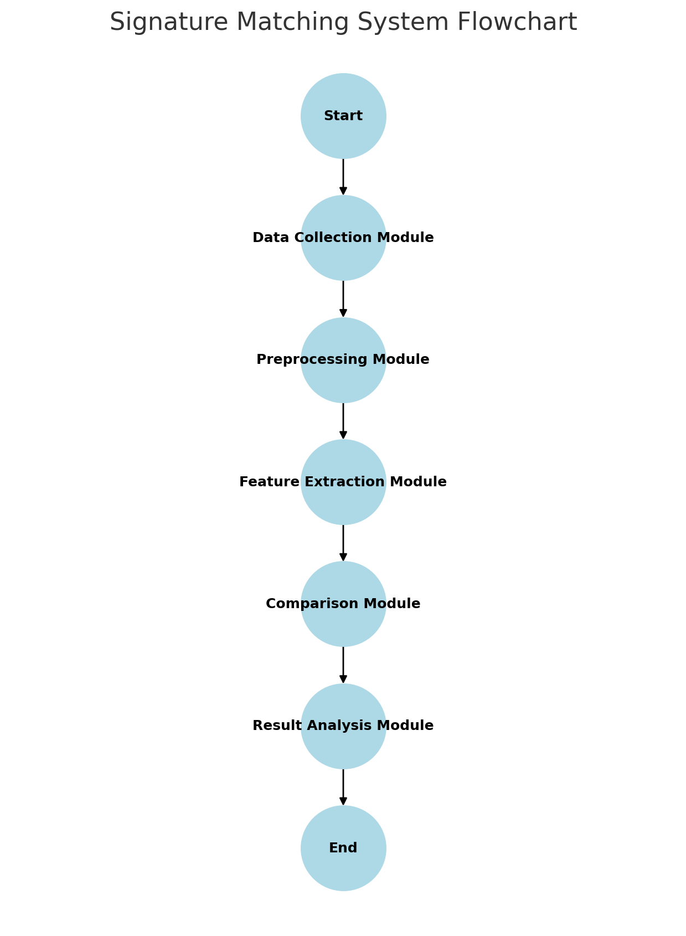

Slide 7
Module Design
Data Collection Module
Captures signature images using webcam or file upload.
Preprocessing Module
Applies image enhancement techniques (grayscale conversion, noise removal).
Feature Extraction Module
Uses edge detection and key-point matching techniques.
Comparison Module
Compares extracted features with stored signatures using similarity thresholds.
Result Analysis Module
Displays the similarity percentage and verification outcome.

Slide 8
Module Design
Module 1: Data Collection & Preprocessing
This module handles the acquisition of signature images, allowing users to either upload an existing image or capture one using a webcam. Once collected, the images undergo preprocessing, including grayscale conversion and noise removal, to enhance clarity and prepare them for feature extraction.
Module 2: Feature Extraction & Comparison
In this stage, the system extracts key features such as edges and unique signature patterns using key-point matching techniques. The extracted features are then compared with stored reference signatures using a similarity threshold. If the similarity exceeds a predefined value (e.g., 85%), the signatures are considered a match; otherwise, they are flagged as non-matching.
Module 3: Result Analysis & Verification
The final module evaluates the comparison results and provides a similarity percentage along with a verification decision. If a forgery is detected, an alert is generated. This module ensures that the verification process is transparent and provides users with a clear and accurate authenticity result.

Slide 9
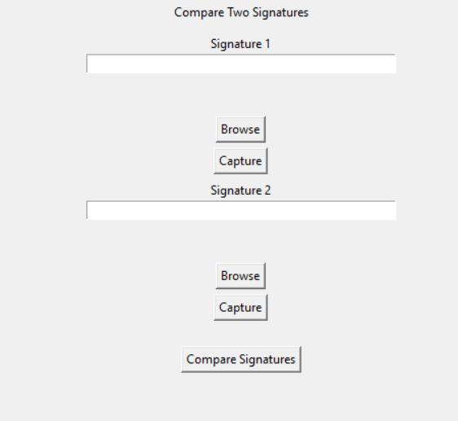
Module 1: Data Collection & Preprocessing
captureImage() and capture_image_from_cam_into_temp() – captures images via webcam.
browsefunc() – allows image upload.
Basic preprocessing steps like grayscale (assumed to be part of match()).

Slide 10
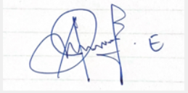
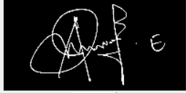
Module 2: Feature Extraction & Comparison
The extracted features are then compared using a similarity matching algorithm.
This module extracts key features from the two signature images using image processing techniques like grayscale conversion, edge detection, and keypoint detection (e.g., ORB/SIFT).
Before processing
After processing
The extracted features are then compared using a similarity matching algorithm.

Slide 11

If the similarity percentage is ≥ 85%, the signatures are considered a match; otherwise, they are flagged as non-matching.
The result is displayed to the user via a popup message.

Slide 12
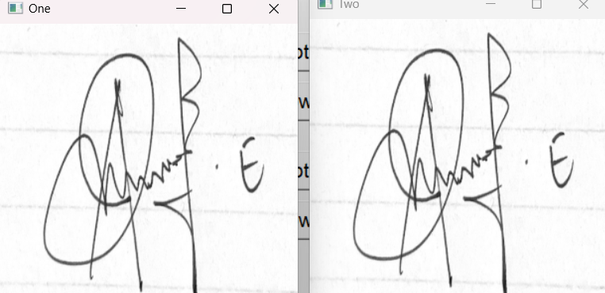
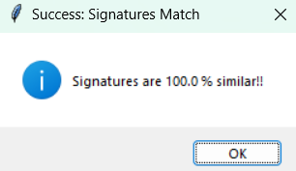
Module 3: Result Analysis & Verification
This module analyzes the similarity score obtained from the comparison.
If the score is ≥ 85%, the signatures are considered a match; otherwise, a mismatch.
The result is shown to the user using a popup message (Success or Failure).
Helps ensure clear and accurate verification feedback.

Slide 13
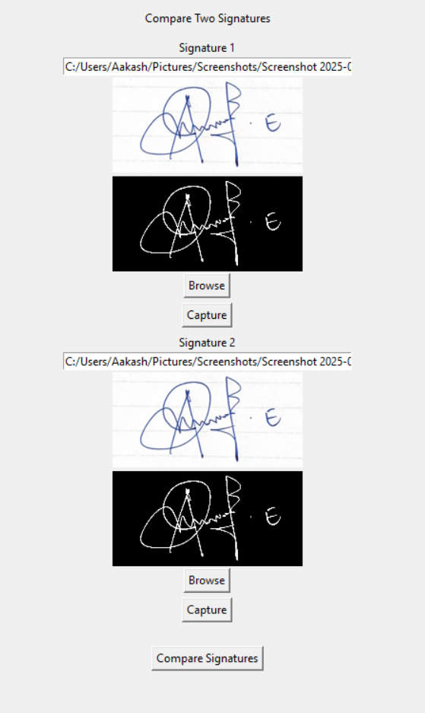
Module 4: GUI Interface & User Interaction
Creating an interactive graphical user interface using Tkinter.
Allowing users to browse and upload signature images.
Providing camera-based signature capture functionality.
Displaying original and preprocessed image previews for both signatures.
Enabling the "Compare Signatures" button that starts the verification process.

Slide 14
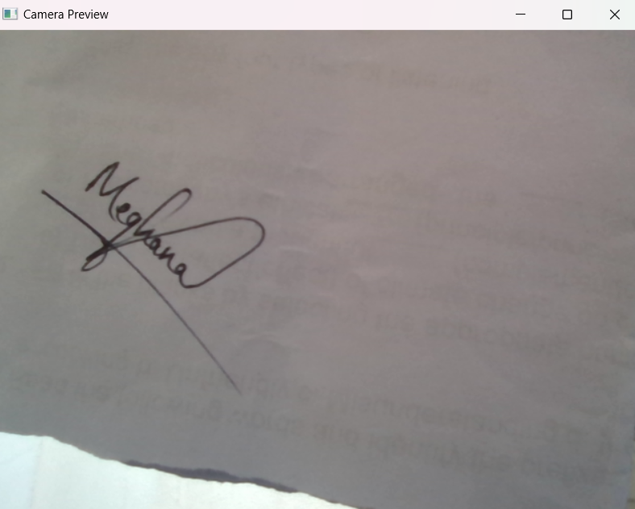
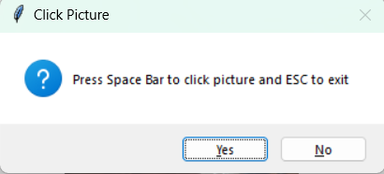
Module 6: Camera Integration
This module handles:
Accessing the webcam using OpenCV.
Capturing frames on spacebar press.
Saving them in a temp/ directory with unique names.
Returning file paths for further processing.

Slide 15
Tools And Technologies To Be Used
Development Tools: PyCharm, VS Code
Programming Languages: Python
Frameworks/Libraries: OpenCV, NumPy, Tkinter
Database: SQLite (for storing reference signatures)
Version Control: Git, GitHub
Additional Tools: Matplotlib (for visualization), PIL (for image handling)

Slide 16
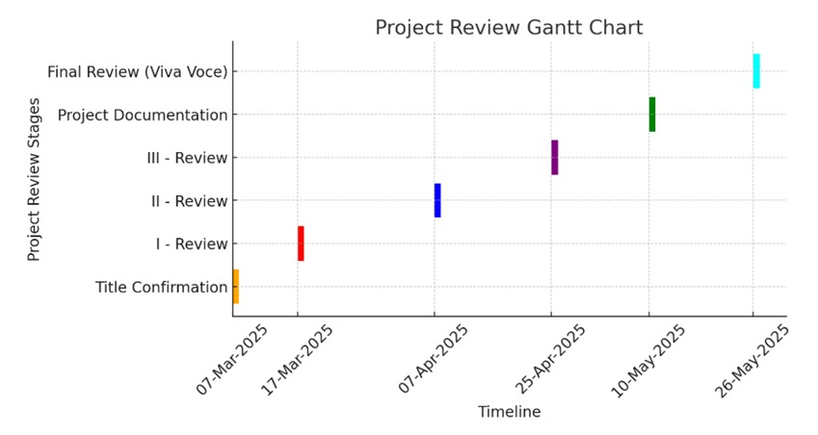
Timeline of the Project

Slide 17
GitHub Link
https://github.com/Aakash29082002/-Fake-Signature-Detection

Slide 18
References
1. R. Gupta and A. Sharma, "Automated Signature Verification Using CNN," Int. J. Comput. Vis., vol. 45, no. 3, pp. 234-245, 2022.
2. J. Patel and S. Reddy, "Signature Forgery Detection Using Machine Learning," IEEE Trans. Inf. Forensics, vol. 28, no. 4, pp. 678-689, 2021.
3. L. Wang and K. Chen, "Offline Handwritten Signature Verification Based on SIFT and HOG Features," Pattern Recognit. Lett., vol. 35, no. 2, pp. 123-135, 2020.
4. T. Singh and M. Rao, "Fake Signature Detection Using Image Processing," J. Digit. Forensics, vol. 18, no. 5, pp. 543-558, 2019.
5. A. Brown and C. Taylor, "Comparative Analysis of Handwritten Signature Verification Techniques," Comput. Secur., vol. 42, no. 1, pp. 87-102, 2018.
6. P. Kumar and S. Verma, "Signature Recognition Using ANN," Neural Netw. J., vol. 55, no. 3, pp. 211-225, 2017.
7. D. Lee and M. Park, "Hybrid Model for Signature Verification," Mach. Learn. Cybersecurity, vol. 23, no. 4, pp. 312-328, 2016.
8. C. Zhang and J. Liu, "Statistical Analysis in Signature Verification," Forensic Sci. Int., vol. 29, no. 6, pp. 190-203, 2015.
9. M. Fernandez and H. Kim, "Dynamic Signature Verification Using Motion Analysis," Biometric Technol. Today, vol. 21, no. 2, pp. 45-57, 2014.
10. R. Singh and B. Natarajan, "Signature Authentication Using Wavelet Transform," IEEE Signal Process. Lett., vol. 18, no. 7, pp. 129-140, 2013.

Slide 19


